Slide 1

Server-Side Architectures (WITH ASP.NET Examples)
Latest Technology Improvements

Slide 2
For questions
https://sli.do #servers

Slide 3
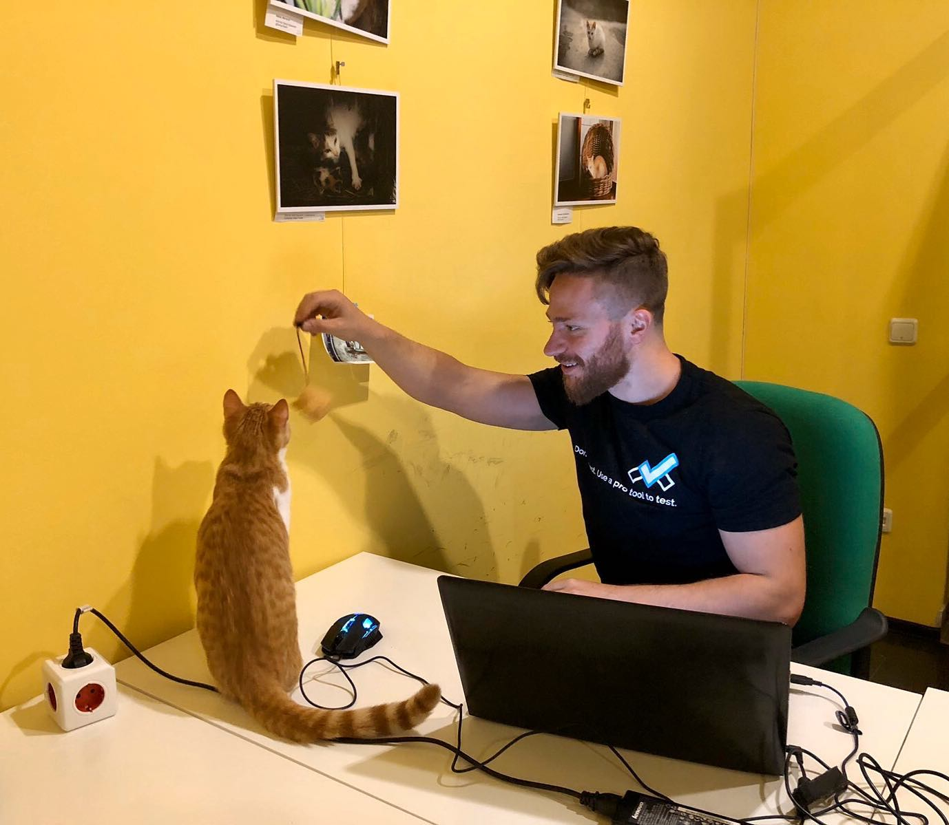
The Presenter
Ivaylo Kenov – Quality Code Advocate
Various job titles at the same time:
CTO @ SoftUni
Full Stack Technical Trainer @ Everywhere
Meme Copy Machine @ Daily Programming Fun
Code General @ https://MyTestedASP.NET
{Insert Jot Title Here}
Contacts
https://github.com/ivaylokenov
https://facebook.com/ivaylo.kenov
https://linkedin.com/in/kenov
YouTube
https://youtube.com/MyTestedASPNETTV

Slide 4
What Are We Going To COVER
The Problem & Why This Topic
The Principles We Search For
The Classic Database-Centric Architecture
Domain-Driven Architecture
Clean Architecture
Bonus: Microservice Architecture
Additional Resources

Slide 5
The Problem & WHY THIS TOPIC

Slide 6
The MVC Pattern Is great but
Server-side technologies are providing us only a simple “front-end” pattern
ASP.NET Core Razor Pages
ASP.NET Core MVC
ASP.NET Core Web API
Java Spring
Node Express
Etc.
Solutions with lots of business logic will get “spaghetti” in no time
Controllers/Components with thousands lines of code
We need scalable solutions
Scalable in terms of development teams, not in terms of throughput

Slide 7
Why THIS TOPIC
Most people recognize the problem and its consequences
But lots of people
Use architecture their teachers told them to use
Repository pattern, for example
Use architecture their managers told them to use
Legacy code with old-school mistakes, for example
Use architecture they read somewhere about
Microservices and other hypes
So I decided to spread the word ☺

Slide 8
The Principles We Search For

Slide 9
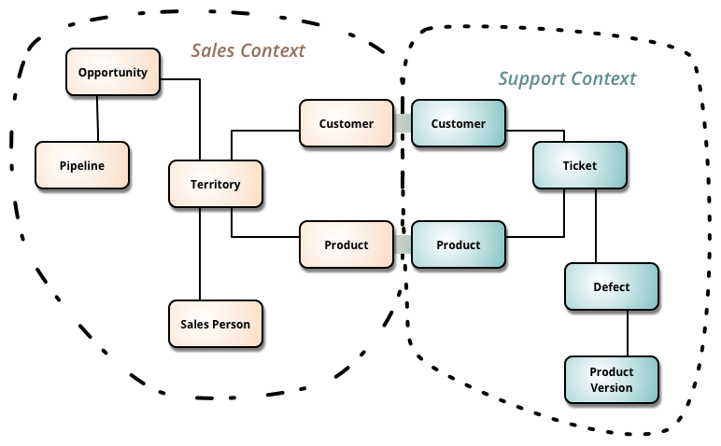
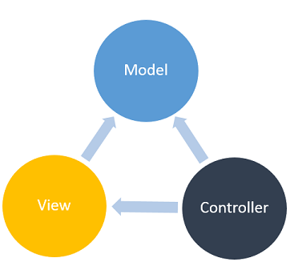
Our architecture needs
Separation of Concerns
Encapsulation
Dependency Inversion
Explicit Dependencies
Single Responsibility
Don’t Repeat Yourself
Persistence Ignorance
Bounded Contexts
Testability

Slide 10
Let’s Start With The Classic Database-centric Architecture

Slide 11
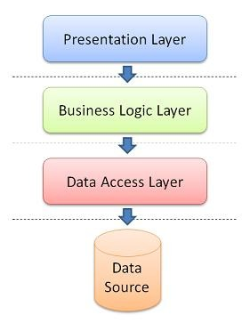
Database-centric Architecture
Database is the center of the application
The business domain and services are built around the database
It usually has the following layers
Presentation – Views or API
Business logic – external services or data-oriented
Data access layer – database-specific logic
The database is first
Application code comes secondary

Slide 12
Database-Centric Architecture DEMO

Slide 13
Database-centric Architecture IS NOT BAD
Pros
Easy to learn
Most people understand it well
It covers most of our architecture needs
Cons
It is not flexible
It was designed for single presentation application (before smartphones)
All dependencies are towards the database

Slide 14
NOW LET’s SEE THE DOMAIN-DRIVEN Architecture

Slide 15
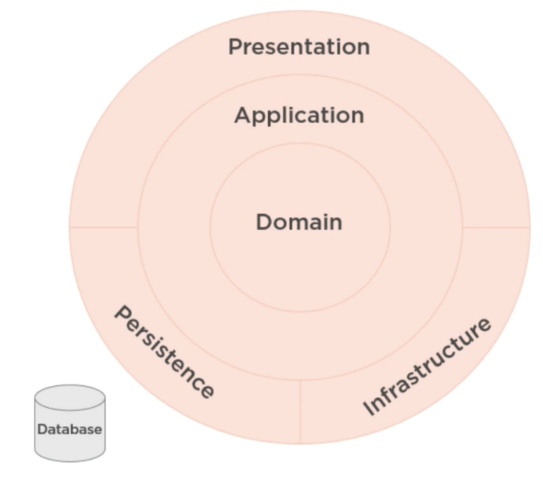
Domain-Driven Design
Domain-Driven Architecture
All dependencies point towards the domain
Communication is done through interfaces
Presentation and its framework are just a detail
The database is just a detail

Slide 16
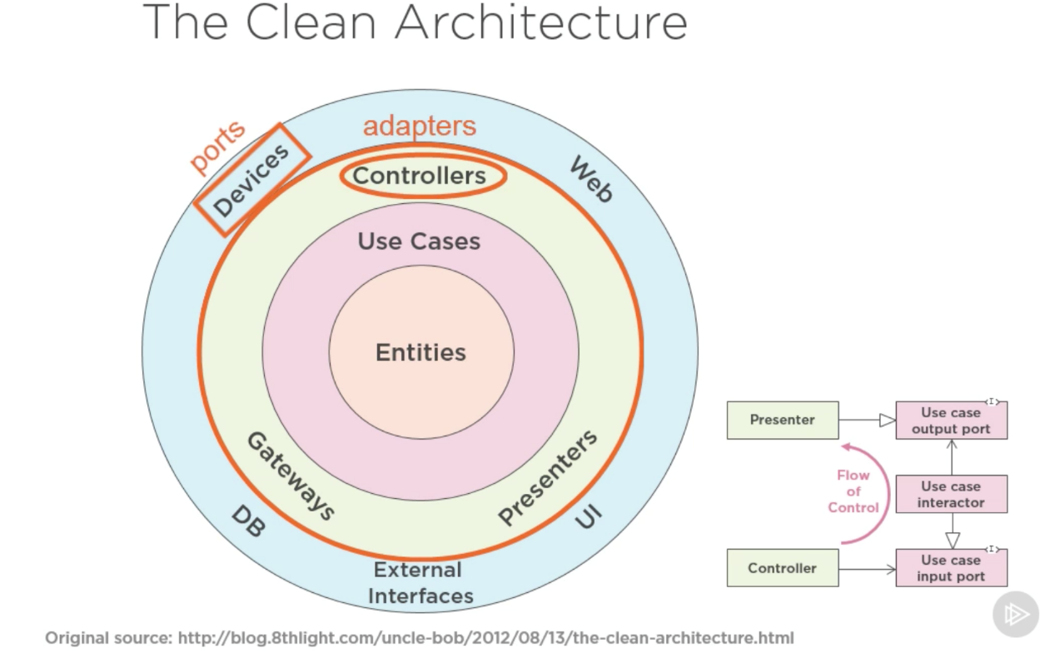
History Lesson
Domain-Driven Architecture is also known as
Hexagonal Architecture
Ports & Adapters
Onion Architecture
Everything Points Toward The Domain
Clean Architecture
The “Latest” Installment

Slide 17
TERMINOLOGY
Entities
The application domain data - may or not be reused by the database
Interactors
Represent use cases
The business logic which interacts with the entities
Uses interfaces and no implementation details (gateways or services)
Boundary
Responsible for translating data from one layer to another
Uses ports (models or results)

Slide 18
DOMAIN-DRIVEN ARCHITECTURE DEMO

Slide 19
DOMAIN-DRIVEN Architecture IS SUPERIOR
Pros
Scalable in terms of development
Code has even better separation
It covers all our architecture needs
Improved patterns and flexibility
Cons
Usable when the business logic is complex
Time-consuming as it needs more classes and relationships between them

Slide 20
LET’s CLEAN THIS THING

Slide 21
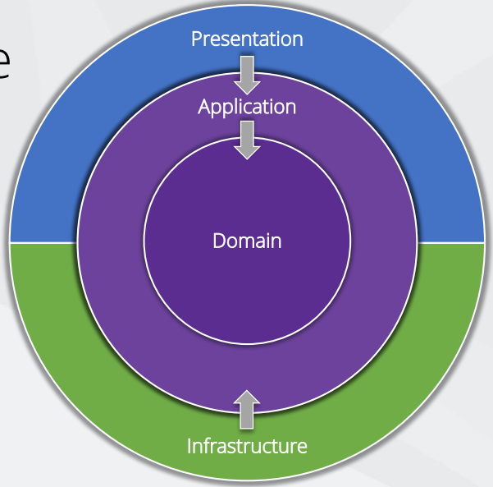
CLEAN ARCHITECTURE
Independent of frameworks
Independent of UI
Independent of database
Independent of anything external
Testable

Slide 22
CLEAN ARCHITECTURE TEMPLATE
.NET Core Template Package
ASP.NET Core 3.1
Entity Framework Core 3.1
ASP.NET Core Identity 3.1
Repository - http://bit.ly/ca-sln
Big Solution Sample - https://bit.ly/northwind-traders

Slide 23
DEFAULT TEMPLATE DEMO

Slide 24
KEY CONCEPTS
Domain contains enterprise-wide logic and types
Application contains business-logic and types, uses interface
Infrastructure contains all external concerns, uses implementations
Presentation and Infrastructure depend only on Application
Infrastructure and Presentation components can be replaced with minimal effort
We pass data between layers with input/output models

Slide 25
CLEAN ARCHITECTURE DEMO

Slide 26
DOMAIN
Entities, Value Objects, Enumerations, Exceptions, Entity Logic
Avoid using data annotations
Create custom domain exceptions
Initialise all collections & use private setters

Slide 27
Application
Interfaces, Models, Logic, Commands & Queries, Validators
Use CQRS – commands & queries – simple and scalable
Easy to add new features
Easy to maintains, one change effect one query
Add MetiatR and save yourself from too much classes
Application layer becomes just input/output objects
Easy to add additional behaviour before or after each request – caching, logging, validation

Slide 28
Application
Using CQRS + MediatR simplifies your overall design
MediatR simplifies cross cutting concerns
Fluent Validation is useful for all validation scenarios
AutoMapper simplifies mapping and projections
Independent of infrastructure concerns

Slide 29
Infrastructure
Persistence, Identity, File System, System Clock, API Clients
Independent of the database
Use Fluent API configuration over data annotations
Prefer conventions over configuration
Automatically apply all entity type configurations
No layers depend on Infrastructure layer, e.g. Presentation layer

Slide 30
Infrastructure
What About Repository Pattern?
It depends, but keep in mind:
EF Core insulates your code from database changes
DbContext acts as a unit of work
DbSet acts as a repository
EF Core has features for unit testing without repositories
Personally, I do not use it anymore

Slide 31
Presentation
Angular, React, Vue, Web API, Razor Pages, MVC, Web Forms
Controllers should not contain any application logic
Create and consume well defined models
Bonus
Open API bridges the gap between the front end and back end
NSwag automates generation of Open API specification and clients

Slide 32
BIG SOLUTION DEMO

Slide 33
LET’s MENTION MICROSERVICES

Slide 34
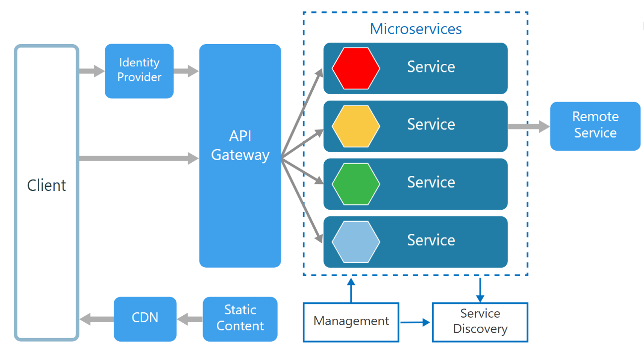
Microservices
Pros
High scalability
Each service is small and independent
Improved isolation
No long-term commitment to technology
Cons
Increased complexity
Logic is split between application
Deployment is difficult
Data consistency is an issue

Slide 35
Microservices May be my next event?
I plan to organize two technical events every month starting April 2020
One networking event – live in a “bar” with guest lecturer (as well as Pizza and stuff)
One online event – live on YouTube/Twitch
Completely free
What should I present next?
Microservices Architecture
Continuous Integration & Deployment
Asynchronous Programming in Detail
Web Security Vulnerabilities
Reflection/Expression Trees/Roslyn
Machine Learning
Something else?

Slide 36
Mentoring program
These events will be part of my new mentoring program
Target – junior to regular programmers with 0 to 2 years practical work
Help with:
Becoming better software developers
Code improvement in terms of quality and logic
Career choices and advancement
Interview preparation
And more
Approach – online groups, additional exclusive lessons, one to one meetings
Just contact me directly, if you want more information ☺

Slide 37
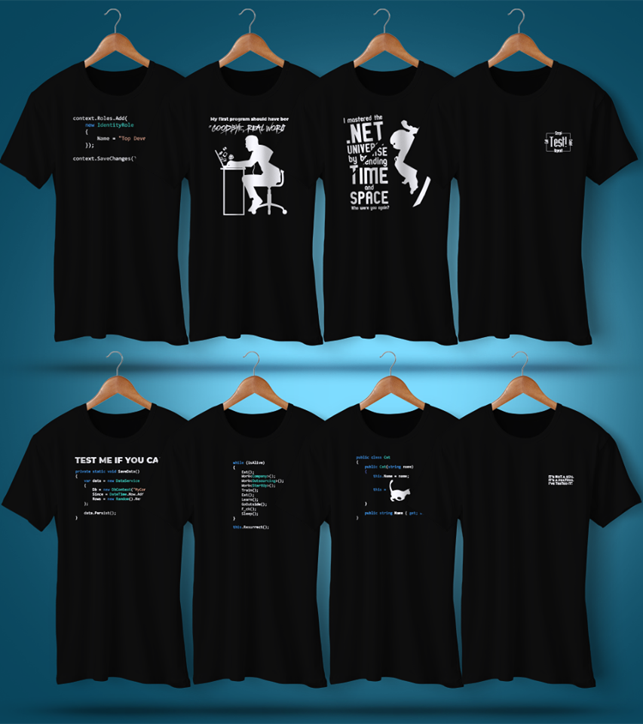
ANY QUESTIONS?
You can support me and my projects:
On Patreon: https://www.patreon.com/ivaylokenov
On Open Collective: https://opencollective.com/mytestedaspnet
Via PayPal: http://paypal.me/ivaylokenov
Via Buy Me A Coffee: http://buymeacoff.ee/ivaylokenov
Crypto: http://bit.ly/ik-sponsors
Or just buy one of my upcomming cool exclusive T-Shirts!
Never expected, always appreciated!

Slide 38
Additional Resources

Slide 39
Additional Resources
The Clean Architecture https://8thlight.com/blog/uncle-bob/2012/08/13/the-clean-architecture.html
The Onion Architecture https://jeffreypalermo.com/blog/the-onion-architecture-part-1/
The Repository Pattern https://deviq.com/repository-pattern/
Clean Architecture Solution Sample https://github.com/ardalis/cleanarchitecture
Architecting Microservices e-book https://aka.ms/MicroservicesEbook
DDD (Domain-Driven Design) https://docs.microsoft.com/dotnet/architecture/microservices/microservice-ddd-cqrs-patterns/

Slide 40
Thank You!
Code and presentation available here: https://github.com/ivaylokenov/ASP.NET-Server-Architectures

